Slide 1


NCAA Bracket Generator Sprint 4
Nate Lang, John Hattas, Kevin Brosam, Alex Berkhout, Matt Petter

Slide 2
Sprint 4 Overview
Main Goal: Improve User Experience
Better Indicator selection
Bracket scoring
High Scores

Slide 3
User Story Example
John wants to use the website easily, from both his desktop and his mobile device. He wants to select multiple indicators and see what percentage of the bracket he got right for previous years. He also wants to see which picks the prediction got right and wrong. He wants to try multiple different ones and see what the overall high score is.

Slide 4
Sample Tests
Test | Expected Outcome | Actual Outcome | What You Did to Fix | Date
Matching predicted with actual result for 2016 | Adds green if match or red if doesn’t match | Returned red when it should return green | Outcomes csv was formatted wrong, changed the formatting | 4/25/2018
Matching predicted with actual result for 14&15 | Adds green if match or red if doesn’t match | Out of length error | Returned the outcomes without names, and prediction without names | 4/25/2018
Displaying points and % games on site | Display correct info in label | Showed a tuple instead of a single value | Passed in first index instead of full value | 4/26/2018
Reading scores files | Gets the full data from the file | File not found in bucket | Made score files public | 4/26/2018
Parsing Scores files | splits the file into each of the scores | Split the file into each part of the score, instead of full scores | split on '|' instead of default | 4/26/2018
Comparing scores to predicted score | indexes through each score and checks if our score is greater | Skipped all if statements when they should have matched | cast the year to an int | 4/26/2018
Formatting output string | Correctly built string | String added an extra "|" at the end | deleted extra "|" | 4/27/2018
Formatting full output array | Output Array writes in a logical format | Output array writes blank | Passed in correct output instead of a blank array | 4/27/2018

Slide 5

PRODUCT DEMO

Slide 6
Backlogs
Sprint Backlog
Product Backlog
Task | Priority [1-10 (1 being lowest)] | Story Points | Completed(Y/N)
% added to website | 8 | 2 | Y
Right and wrong picks added to website, with colors | 9 | 2 | Y
Weighting feature working correctly | 8 | 3 | Y
Add 2018 | 10 | 1 | Y
Reset button | 5 | 1 | Y
More indicators | 5 | 1 | Y
Normalize data, make opponent stats negative | 10 | 2 | Y
Display weighing formula | 4 | 1 | Y
Test with another group | 10 | 2 | Y
High score | 3 | 2 | Y
Task | Priority [1-10 (1 being lowest)] | Story Points | Completed(Y/N)
Develop an algorithm that predicts future tournament results | 1 | 1 | N
Integrate more advanced statistics | 7 | 3 | Y
Create picture of the bracket with appropriate teams | 7 | 2 | Y
Collect Data | 10 | 2 | Y
Have a basic working model | 10 | 2 | Y
Potentially display through HTML | 1 | 4 | Y
Update for 2018 tournament | 3 | 1 | Y
Display data in charts and tables | 5 | 1 | Y
Create User Interface | 4 | 4 | Y
Host website | 9 | 2 | Y
Create working website model | 8 | 3 | Y
Merge website and python code to work together effectively | 8 | 4 | Y

Slide 7
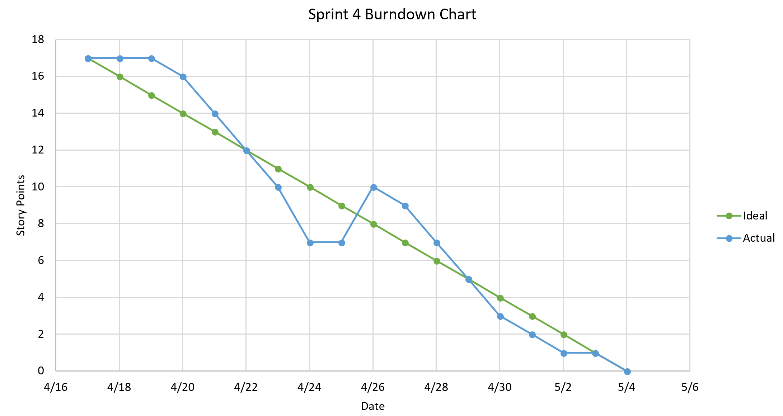
Burndown Chart: Velocity = 1 point/day

Slide 8
Testing Another Group
Created account, edited account, deleted account
Upload photos, use maps, use calendars
Create profile and try to break with strange characters
Button mash testing
Test all buttons and interfaces to make sure they work
Site works great

Slide 9
Sprint Retrospective
Created nice user experience
Completed all sprint tasks and added extra
Better test documentation
Consistent daily scrums/updates
Great final working product that can be used by anyone

